Slide 1
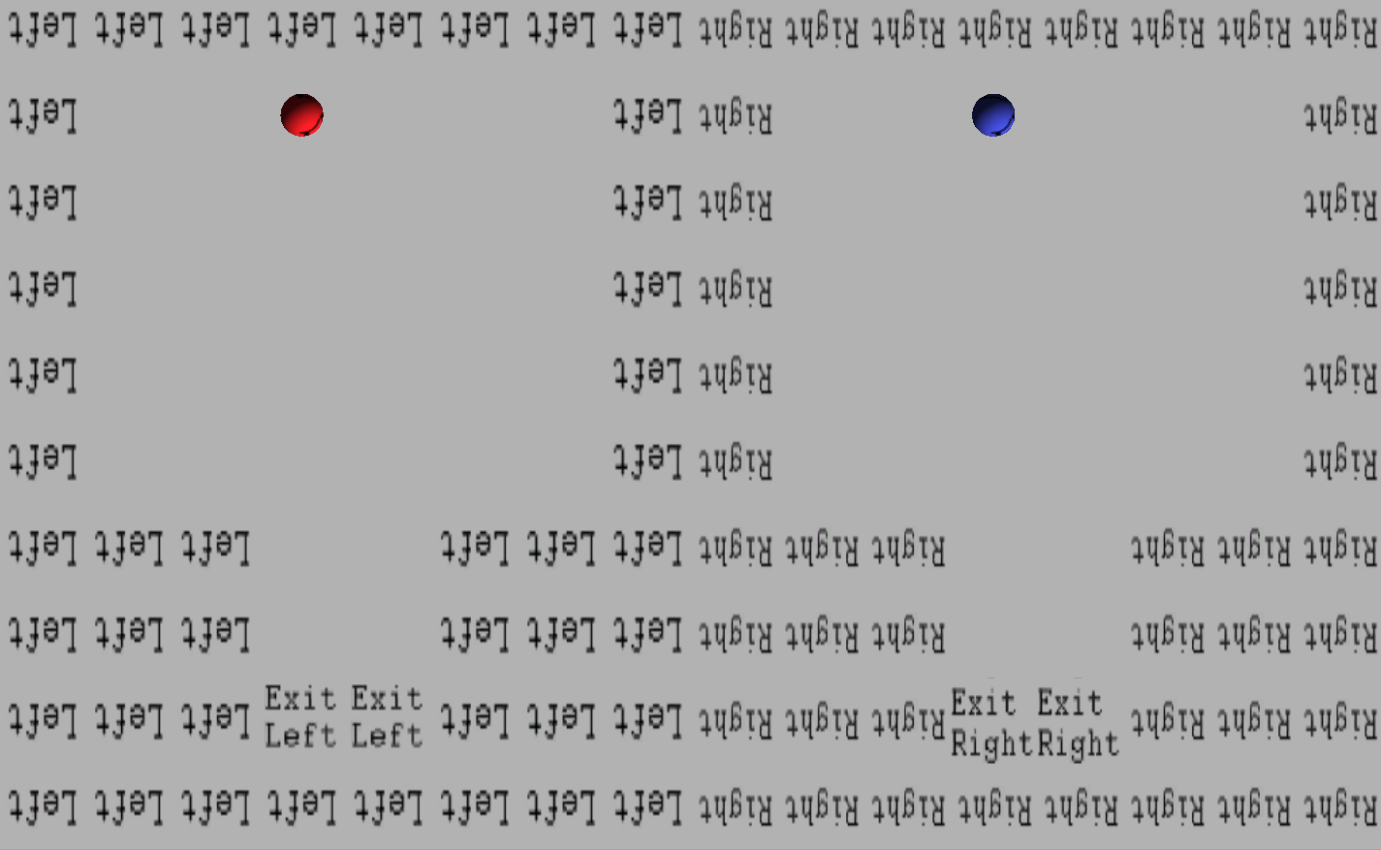
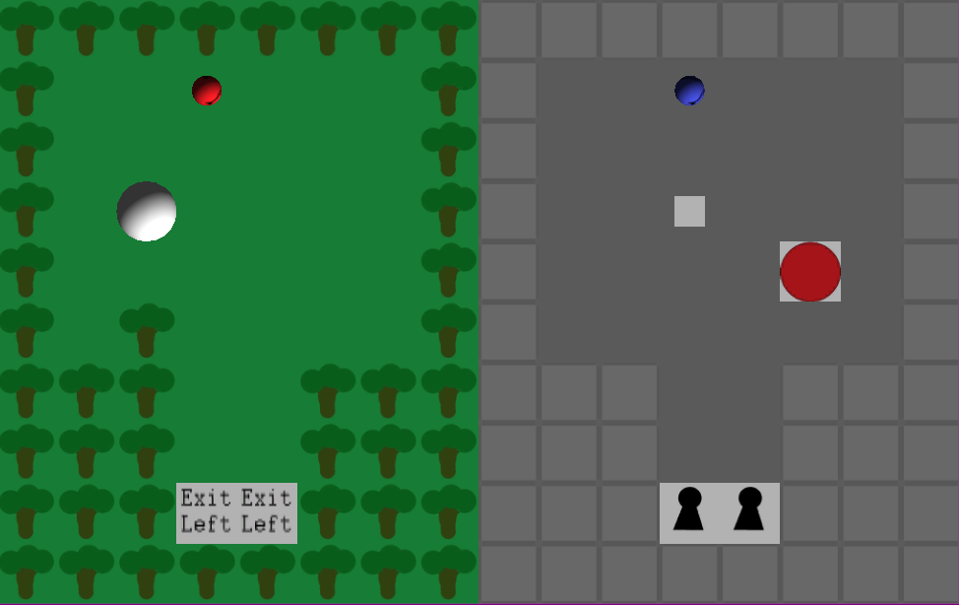
BEARS!
Max Topan

Slide 2
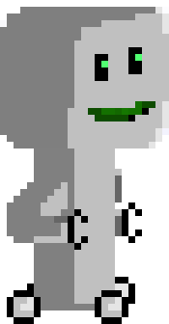

Narrative
Inventor creates Robot controlled by movement
Inventor takes into woods
Two get separated
Inventor must reunite with Robot

Slide 3
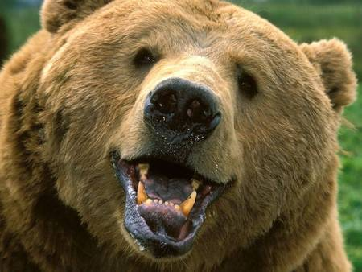
What is ‘Bears!’?
Top-down puzzle game
Control two characters
Small, self-contained, levels

Slide 4

Why A Puzzle Game?
Adaptable
Mobile and Tablet
Expandable
Easy to create new levels
User created content

Slide 5
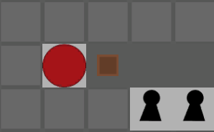
Current Mechanics and Features
Controlling two characters
Tile based movement
Locked doors
Pushable boxes
Switches
Bears
Restart button

Slide 6

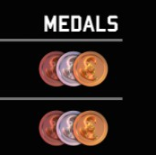
Potential Mechanics and Features
Will have
Water
Pitfalls
Could have
Medal based reward system
User friendly level editor
Smartphone version

Slide 7
Questions?

